Slide 1
Randomized Algorithms CS648
Lecture 15
Random Sampling
To find a subset with a desired property
Optimizing the number of random bits

Slide 2
Random Sampling
(To efficiently find a subset
with a desired property)

Slide 3
Random Sampling
Suppose there is a computational problem
where we require to find a subset with some desired properties.
Unfortunately, computing such a set deterministically
looks just too difficult and/or may take huge time.
Random sampling carried out suitably
may produce a subset with the desired property with some probability.

Slide 4
A real life example
We need a donor with blood group O+.
There is a huge list (1 million) of blood donors.
Unfortunately, the blood group information of donors is lost .
What to do ?
IDEA:
Repeat until we get a donor of blood group O+.
{ Pick the phone number of a donor randomly uniformly
Call him/her to ask his/her Blood group.
}
37% people are O+
(Select a random subset of donors.)

Slide 5

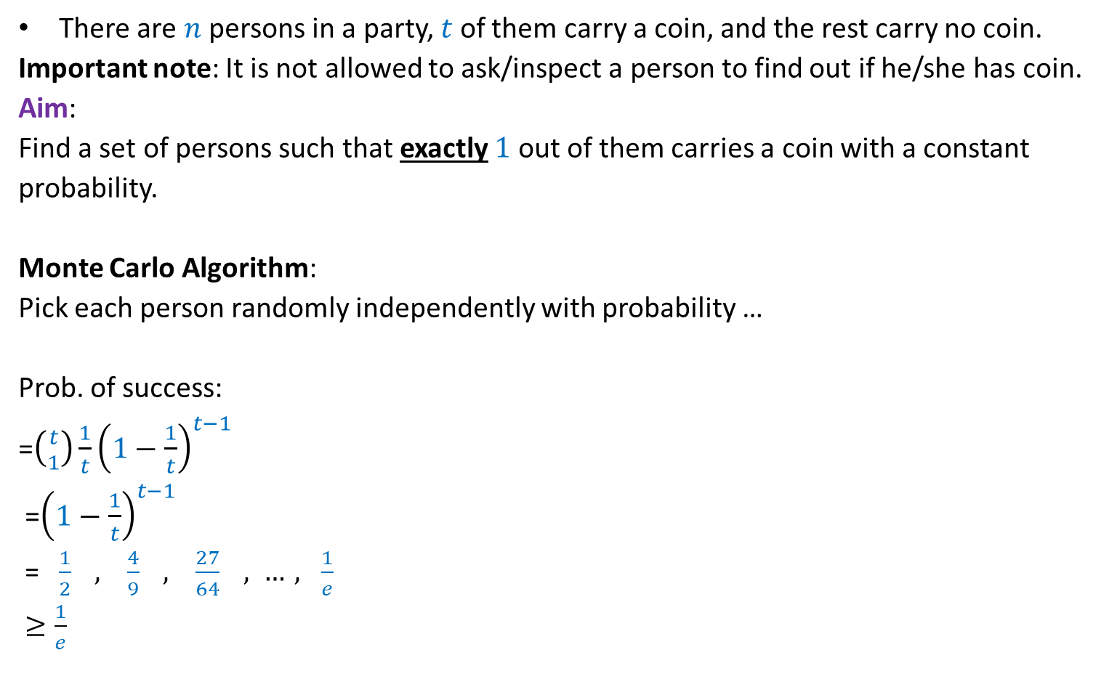
A generic example
There are $n$ persons in a party, $t$ of them carry a coin, and the rest carry no coin.
Important note: It is not allowed to ask/inspect a person to find out if he/she has coin.
Aim:
Find a set of persons such that exactly $1$ out of them carries a coin with a constant
probability.
Monte Carlo Algorithm:
Pick each person randomly independently with probability …
Prob. of success:
=$\left({t \atop 1}\right)\frac{1}{t}{\left(1−\frac{1}{t}\right)}^{t−1}$
=${\left(1−\frac{1}{t}\right)}^{t−1}$
= $\frac{1}{2} , \frac{4}{9} , \frac{27}{64} , …, \frac{1}{e}$
$≥\frac{1}{e}$
$$\frac{1}{t}$$

Slide 6
Randomized Algorithm for
BPWM problem
(Boolean Product Witness Matrix)

Slide 7

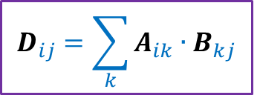

Integer Product of Matrices
Boolean
$$j$$
$$j$$
1 | 0 | 0 | 1 | 0
1 | 0 | 0 | 0 | 1
0 | 0 | 1 | 0 | 0
0 | 1 | 0 | 1 | 0
1 | 1 | 0 | 1 | 0
1 | 0 | 1 | 0 | 0
0 | 1 | 1 | 0 | 1
1 | 1 | 1 | 1 | 0
1 | 1 | 1 | 0 | 0
1 | 0 | 0 | 1 | 0
2 | 1 | 2 | 0 | 0
2 | 0 | 1 | 0 | 0
1 | 1 | 1 | 1 | 0
1 | 2 | 2 | 0 | 1
2 | 2 | 3 | 0 | 1
$$i$$
$$i$$
A
B
D
$$D_{ij}=\sum_{k}{A_{ik}{∙B}_{kj}}$$

Slide 8
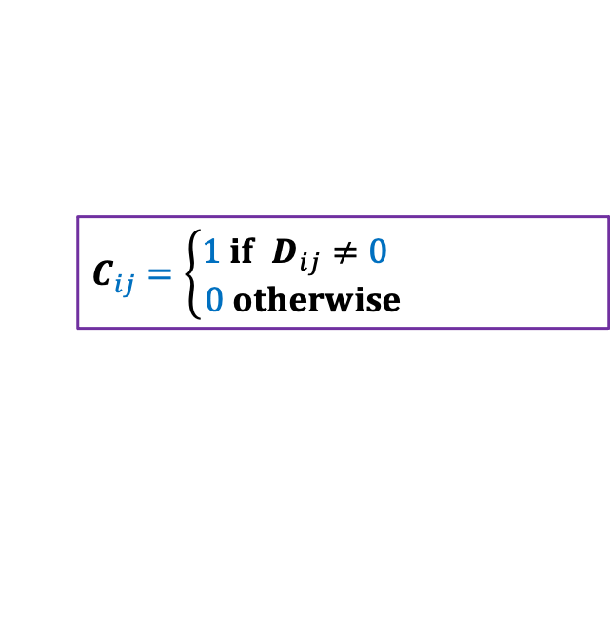
Boolean Product of Matrices
$$j$$
1 | 0 | 0 | 1 | 0
1 | 0 | 0 | 0 | 1
0 | 0 | 1 | 0 | 0
0 | 1 | 0 | 1 | 0
1 | 1 | 0 | 1 | 0
1 | 0 | 0 | 1 | 0
1 | 0 | 0 | 0 | 1
0 | 0 | 1 | 0 | 0
0 | 1 | 0 | 1 | 0
1 | 1 | 0 | 1 | 0
1 | 0 | 1 | 0 | 0
0 | 1 | 1 | 0 | 1
1 | 1 | 1 | 1 | 0
1 | 1 | 1 | 0 | 0
1 | 0 | 0 | 1 | 0
1 | 1 | 1 | 0 | 0
1 | 0 | 1 | 0 | 0
1 | 1 | 1 | 1 | 0
1 | 1 | 1 | 0 | 1
1 | 1 | 1 | 0 | 1
$$i$$
A
B
C
$$C_{ij}=\left\{\begin{aligned}1 if D_{ij}≠0 \\ 0 otherwise \end{aligned}\right.$$

Slide 9
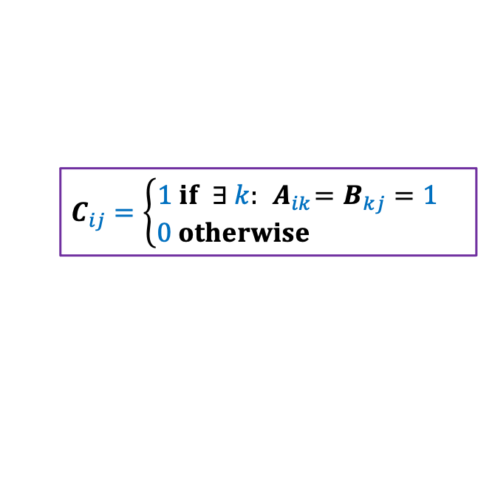
Boolean Product of Matrices
$$j$$
1 | 0 | 0 | 1 | 0
1 | 0 | 0 | 0 | 1
0 | 0 | 1 | 0 | 0
0 | 1 | 0 | 1 | 0
1 | 1 | 0 | 1 | 0
1 | 0 | 0 | 1 | 0
1 | 0 | 0 | 0 | 1
0 | 0 | 1 | 0 | 0
0 | 1 | 0 | 1 | 0
1 | 1 | 0 | 1 | 0
1 | 0 | 1 | 0 | 0
0 | 1 | 1 | 0 | 1
1 | 1 | 1 | 1 | 0
1 | 1 | 1 | 0 | 0
1 | 0 | 0 | 1 | 0
1 | 1 | 1 | 0 | 0
1 | 0 | 1 | 0 | 0
1 | 1 | 1 | 1 | 0
1 | 1 | 1 | 0 | 1
1 | 1 | 1 | 0 | 1
$$i$$
A
B
C
$$C_{ij}=\left\{\begin{aligned}1 if ∃ k:{ A}_{ik}=B_{kj}=1 \\ 0 otherwise \end{aligned}\right.$$
Definition: An integer $k∈[n]$is said to be witness for a pair ($i,j$) if ${ A}_{ik}=B_{kj}=1$

Slide 10

Boolean Product Witness Matrix (BPWM)
Problem:
Given two Boolean matrices A and B, and their Boolean product C,
compute a matrix $W$, such that:
$W_{ij}$ stores a witness for each ($i,j$) with $C_{ij}=1$.

Slide 11
Motivation for BPWM

Slide 12





All Pairs Shortest Paths (APSP)
Standard Algorithms:
Floyd Warshal Algorithm
Dijkstra’s Algorithm
BFS traversal (for unweighted graphs)
O$(n^{3})$ time in the worst case
Raimund Seidel,
JCSS, 51(3): 400-403 ,$1995$
APSP
Matrix Multiplication
O$(n^{ω}\log^{2}{n})$ time
O$(n^{ω})$ time
$ω$<$2.317$

Slide 13
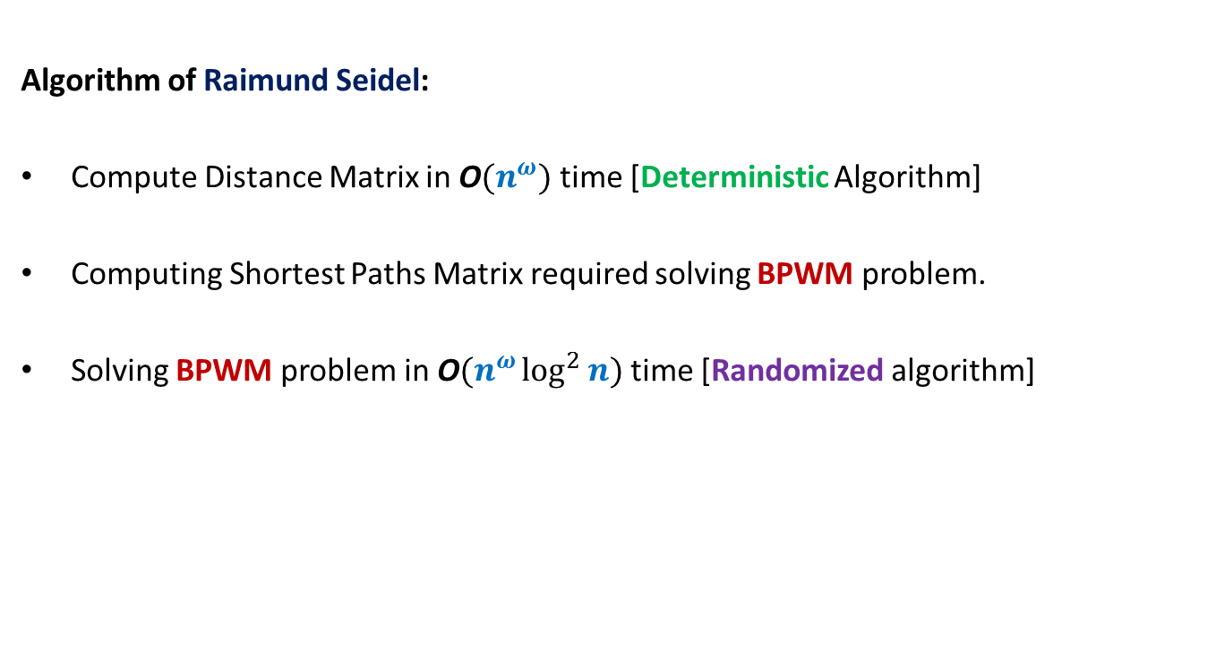
All Pairs Shortest Paths (APSP)
Algorithm of Raimund Seidel:
Compute Distance Matrix in O$(n^{ω})$ time [Deterministic Algorithm]
Computing Shortest Paths Matrix required solving BPWM problem.
Solving BPWM problem in O$(n^{ω}\log^{2}{n})$ time [Randomized algorithm]

Slide 14
Randomized algorithm for BPWM

Slide 15

Boolean Product Witness Matrix (BPWM)
Problem: Given two Boolean matrices A and B, and their Boolean product C,
compute a matrix $W$, such that:
$W_{ij}$ stores a witness for each ($i,j$) with $C_{ij}=1$.
Let us make some simple observations first.

Slide 16


Observations
$$j$$
1 | 0 | 0 | 1 | 0
1 | 0 | 0 | 0 | 1
0 | 0 | 1 | 0 | 0
0 | 1 | 0 | 1 | 0
1 | 1 | 0 | 1 | 0
1 | 0 | 1 | 0 | 0
0 | 1 | 1 | 0 | 1
1 | 1 | 1 | 1 | 0
1 | 1 | 1 | 0 | 0
1 | 0 | 0 | 1 | 0
1 | 1 | 1 | 0 | 0
1 | 0 | 1 | 0 | 0
1 | 1 | 1 | 1 | 0
1 | 1 | 1 | 0 | 1
1 | 1 | 1 | 0 | 1
$$i$$
A
B
C
There may be many witnesses for a pair ($i,j$) .
But our aim is to compute “just one witness” for each pair.
Witnesses for ($i$,$j$)

Slide 17

Observations
$$j$$
1 | 0 | 0 | 1 | 0
1 | 0 | 0 | 0 | 1
0 | 0 | 1 | 0 | 0
0 | 1 | 0 | 1 | 0
1 | 1 | 0 | 1 | 0
1 | 0 | 1 | 0 | 0
0 | 1 | 1 | 0 | 1
1 | 1 | 1 | 1 | 0
1 | 1 | 1 | 0 | 0
1 | 0 | 0 | 1 | 0
1 | 1 | 1 | 0 | 0
1 | 0 | 1 | 0 | 0
1 | 1 | 1 | 1 | 0
1 | 1 | 1 | 0 | 1
1 | 1 | 1 | 0 | 1
$$i$$
A
B
C
How efficiently can we search a witness for a pair ($i,j$) ?
O($n$) time

Slide 18


Observations
$$j$$
1 | 0 | 0 | 1 | 0
1 | 0 | 0 | 0 | 1
0 | 0 | 1 | 0 | 0
0 | 1 | 0 | 1 | 0
1 | 1 | 0 | 1 | 0
1 | 0 | 1 | 0 | 0
0 | 1 | 1 | 0 | 1
1 | 1 | 1 | 1 | 0
1 | 1 | 1 | 0 | 0
1 | 0 | 0 | 1 | 0
1 | 1 | 1 | 0 | 0
1 | 0 | 1 | 0 | 0
1 | 1 | 1 | 1 | 0
1 | 1 | 1 | 0 | 1
1 | 1 | 1 | 0 | 1
$$i$$
A
B
C
How efficiently can you verify if $k$ is a witness for a pair ($i,j$) ?
Just check whether${ A}_{ik}=B_{kj}=1$.
O($1$) time

Slide 19



Boolean Product of Matrices
$$j$$
1 | 0 | 0 | 1 | 0
1 | 0 | 0 | 0 | 1
0 | 0 | 1 | 0 | 0
0 | 1 | 0 | 1 | 0
1 | 1 | 0 | 1 | 0
1 | 0 | 1 | 0 | 0
0 | 1 | 1 | 0 | 1
1 | 1 | 1 | 1 | 0
1 | 1 | 1 | 0 | 0
1 | 0 | 0 | 1 | 0
1 | 1 | 1 | 0 | 0
1 | 0 | 1 | 0 | 0
1 | 1 | 1 | 1 | 0
1 | 1 | 1 | 0 | 1
1 | 1 | 1 | 0 | 1
$$i$$
A
B
C
Look carefully at the integer product matrix D. Does it have any thing to do with witnesses.
$D_{ij}$= number of witnesses for ($i,j$)
Integer
Product
2 | 1 | 2 | 0 | 0
2 | 0 | 1 | 0 | 0
1 | 1 | 1 | 1 | 0
1 | 2 | 2 | 0 | 1
2 | 2 | 3 | 0 | 1
So it is worth studying $D$ for our problem
$$D_{ij}=\sum_{k}{A_{ik}{∙B}_{kj}}$$
D
Notes:
C just stores 0-1 entries and does not provide any information about witnesses.
Let us look at matrix D which stores some numbers …

Slide 20
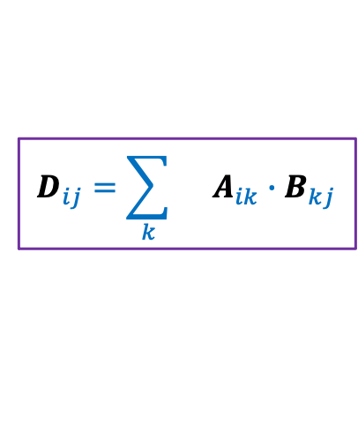
Integer Product of Matrices
1 | 0 | 0 | 1 | 0
1 | 0 | 0 | 0 | 1
0 | 0 | 1 | 0 | 0
0 | 1 | 0 | 1 | 0
1 | 1 | 0 | 1 | 0
1 | 0 | 1 | 0 | 0
0 | 1 | 1 | 0 | 1
1 | 1 | 1 | 1 | 0
1 | 1 | 1 | 0 | 0
1 | 0 | 0 | 1 | 0
2 | 1 | 2 | 0 | 0
2 | 0 | 1 | 0 | 0
1 | 1 | 1 | 1 | 0
1 | 2 | 2 | 0 | 1
2 | 2 | 3 | 0 | 1
A
B
D
$$D_{ij}=\sum_{k}{ A_{ik}{∙B}_{kj}}$$

Slide 21
Integer Product of Matrices
1 | 0 | 0 | 1 | 0
1 | 0 | 0 | 0 | 1
0 | 0 | 1 | 0 | 0
0 | 1 | 0 | 1 | 0
1 | 1 | 0 | 1 | 0
1 | 0 | 1 | 0 | 0
0 | 1 | 1 | 0 | 1
1 | 1 | 1 | 1 | 0
1 | 1 | 1 | 0 | 0
1 | 0 | 0 | 1 | 0
2 | 1 | 2 | 0 | 0
2 | 0 | 1 | 0 | 0
1 | 1 | 1 | 1 | 0
1 | 2 | 2 | 0 | 1
2 | 2 | 3 | 0 | 1
A
B
D
$$D_{ij}=\sum_{k}{ A_{ik}{∙B}_{kj}}$$

Slide 22

Integer Product of Matrices
1
2
3
4
5
⨯
⨯
⨯
⨯
⨯
1 | 0 | 0 | 1 | 0
1 | 0 | 0 | 0 | 1
0 | 0 | 1 | 0 | 0
0 | 1 | 0 | 1 | 0
1 | 1 | 0 | 1 | 0
1 | 0 | 1 | 0 | 0
0 | 1 | 1 | 0 | 1
1 | 1 | 1 | 1 | 0
1 | 1 | 1 | 0 | 0
1 | 0 | 0 | 1 | 0
2 | 1 | 2 | 0 | 0
2 | 0 | 1 | 0 | 0
1 | 1 | 1 | 1 | 0
1 | 2 | 2 | 0 | 1
2 | 2 | 3 | 0 | 1
A
B
D
$$D_{ij}=\sum_{k}{ A_{ik}{∙B}_{kj}}$$
$$k⋅$$
There is a way to manipulate A so that D will store a witness for all those pairs which have singleton witness. Can you guess ?

Slide 23
Integer Product of Matrices
1
2
3
4
5
⨯
⨯
⨯
⨯
⨯
1 | 0 | 0 | 1 | 0
1 | 0 | 0 | 0 | 1
0 | 0 | 1 | 0 | 0
0 | 1 | 0 | 1 | 0
1 | 1 | 0 | 1 | 0
1 | 0 | 1 | 0 | 0
0 | 1 | 1 | 0 | 1
1 | 1 | 1 | 1 | 0
1 | 1 | 1 | 0 | 0
1 | 0 | 0 | 1 | 0
2 | 4 | 2 | 0 | 0
2 | 0 | 1 | 0 | 0
3 | 3 | 3 | 3 | 0
2 | 2 | 2 | 0 | 2
2 | 2 | 3 | 0 | 2
A
B
D
$$D_{ij}=\sum_{k}{ A_{ik}{∙B}_{kj}}$$
$$k⋅$$

Slide 24
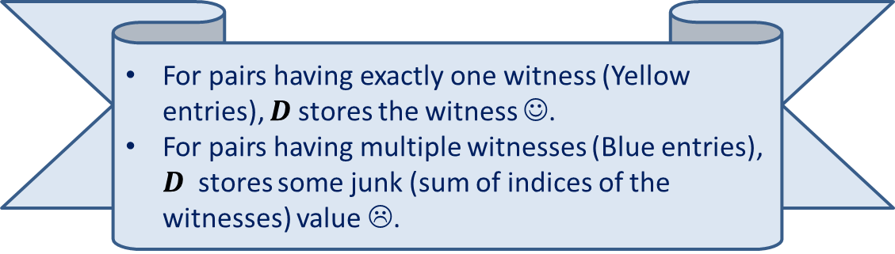
Integer Product of Matrices
1 2 3 4 5
⨯ ⨯ ⨯ ⨯ ⨯
1 | 0 | 0 | 1 | 0
1 | 0 | 0 | 0 | 1
0 | 0 | 1 | 0 | 0
0 | 1 | 0 | 1 | 0
1 | 1 | 0 | 1 | 0
1 | 0 | 1 | 0 | 0
0 | 1 | 1 | 0 | 1
1 | 1 | 1 | 1 | 0
1 | 1 | 1 | 0 | 0
1 | 0 | 0 | 1 | 0
5 | 4 | 5 | 0 | 0
6 | 0 | 1 | 0 | 0
3 | 3 | 3 | 3 | 0
2 | 6 | 6 | 0 | 2
5 | 6 | 7 | 0 | 2
A
B
D
For pairs having exactly one witness (Yellow entries), $D$stores the witness ☺.
For pairs having multiple witnesses (Blue entries), $D$ stores some junk (sum of indices of the witnesses) value ☹.

Slide 25

Algorithm for Computing Singleton Witnesses
Compute-Singleton-Witnesses($A$,$B$)
{ For each $i,k∈[n]$
$A_{ik}$← $k$∙ $A_{ik}$;
$D′$← $A$ ∙ $B$;
For each $i,j∈[n]$
If $D_{ij}^{′}$ is a witness for ($i,j$)
$W_{ij}$← $D_{ij}^{′}$
}
Time complexity: O$(n^{ω})$
A deterministic Algorithm

Slide 26
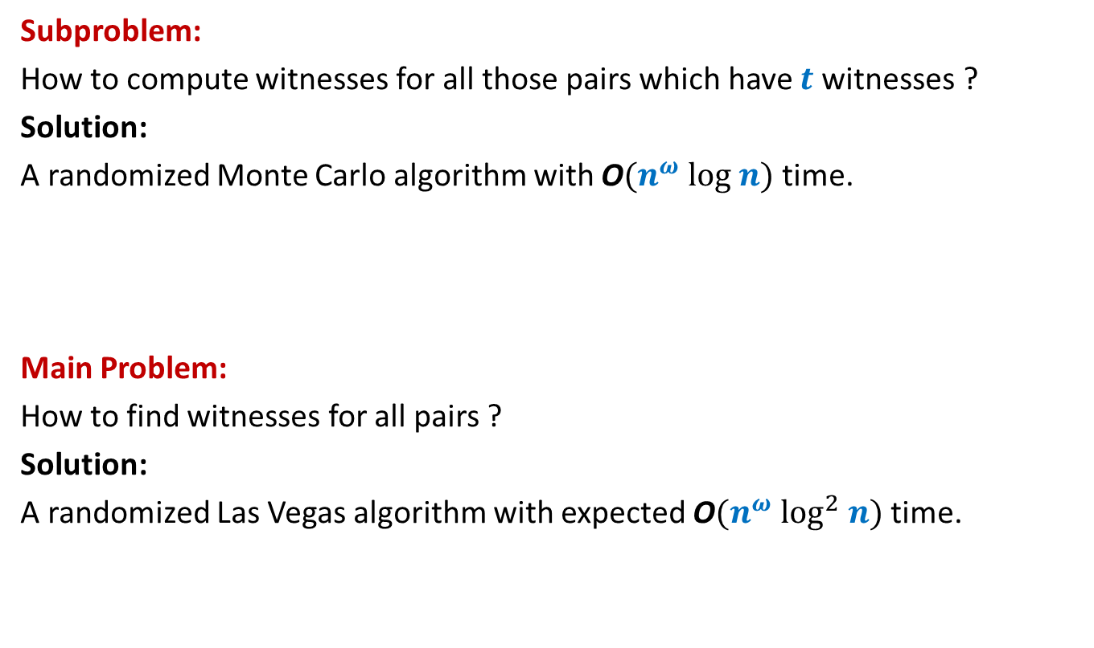
Algorithm Design for BPWM
Subproblem:
How to compute witnesses for all those pairs which have $t$witnesses ?
Solution:
A randomized Monte Carlo algorithm with O$(n^{ω} log n)$ time.
Main Problem:
How to find witnesses for all pairs ?
Solution:
A randomized Las Vegas algorithm with expected O$(n^{ω} \log^{2} n)$ time.
?

Slide 27
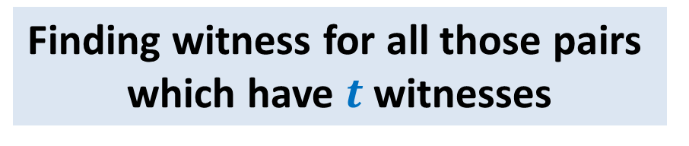

Randomized O$(n^{ω} log n)$ Algorithm:
Finding witness for all those pairs
which have $t$witnesses
Focus on a single pair
Boost success probability by repetition
Union Theorem

Slide 28

Focus on a single pair ($i$,$j$)
$$j$$
1 | 0 | 1 | 1 | 1 | 0 | 0 | 1 | 0 | 1
 |  |  |  |  |  |  | 1
 |  |  |  |  |  |  | 1
 |  |  |  |  |  |  | 0
 |  |  |  |  |  |  | 1
 |  |  |  |  |  |  | 1
 |  |  |  |  |  |  | 0
 |  |  |  |  |  |  | 1
 |  |  |  |  |  |  | 1
 |  |  |  |  |  |  | 0
 |  |  |  |  |  |  | 0
$$i$$
A
B

Slide 29

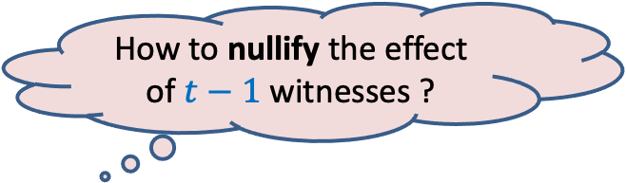
Focus on a single pair ($i$,$j$)
$$j$$
1 2 3 4 … n
⨯ ⨯ ⨯ ⨯ ⨯ ⨯ ⨯ ⨯ ⨯ ⨯
1 | 0 | 1 | 1 | 1 | 0 | 0 | 1 | 0 | 1
 |  |  |  |  |  |  | 1
 |  |  |  |  |  |  | 1
 |  |  |  |  |  |  | 0
 |  |  |  |  |  |  | 1
 |  |  |  |  |  |  | 1
 |  |  |  |  |  |  | 0
 |  |  |  |  |  |  | 1
 |  |  |  |  |  |  | 1
 |  |  |  |  |  |  | 0
 |  |  |  |  |  |  | 0
$$i$$
A
B
How to nullify the effect of $t−1$witnesses ?
Witnesses for ($i$,$j$)

Slide 30
Focus on a single pair ($i$,$j$)
$$j$$
1 2 3 4 … n
⨯ ⨯ ⨯ ⨯ ⨯ ⨯ ⨯ ⨯ ⨯ ⨯
1 | 0 | 1 | 1 | 1 | 0 | 0 | 1 | 0 | 1
 |  |  |  |  |  |  | 1
 |  |  |  |  |  |  | 1
 |  |  |  |  |  |  | 0
 |  |  |  |  |  |  | 1
 |  |  |  |  |  |  | 1
 |  |  |  |  |  |  | 0
 |  |  |  |  |  |  | 1
 |  |  |  |  |  |  | 1
 |  |  |  |  |  |  | 0
 |  |  |  |  |  |  | 0
$$i$$
A
B

Slide 31
Focus on a single pair ($i$,$j$)
$$j$$
1 2 3 4 5 … n-1 n
⨯ ⨯ ⨯ ⨯ ⨯ ⨯ ⨯ ⨯ ⨯ ⨯
1 | 0 | 1 | 1 | 1 | 0 | 0 | 1 | 0 | 1
 |  |  |  |  |  |  | 1
 |  |  |  |  |  |  | 1
 |  |  |  |  |  |  | 0
 |  |  |  |  |  |  | 1
 |  |  |  |  |  |  | 1
 |  |  |  |  |  |  | 0
 |  |  |  |  |  |  | 1
 |  |  |  |  |  |  | 1
 |  |  |  |  |  |  | 0
 |  |  |  |  |  |  | 0
$$i$$
A
B

Slide 32

Focus on a single pair ($i$,$j$)
$$j$$
0 2 3 0 5 … n-1 0
⨯ ⨯ ⨯ ⨯ ⨯ ⨯ ⨯ ⨯ ⨯ ⨯
1 | 0 | 1 | 1 | 1 | 0 | 0 | 1 | 0 | 1
 |  |  |  |  |  |  | 1
 |  |  |  |  |  |  | 1
 |  |  |  |  |  |  | 0
 |  |  |  |  |  |  | 1
 |  |  |  |  |  |  | 1
 |  |  |  |  |  |  | 0
 |  |  |  |  |  |  | 1
 |  |  |  |  |  |  | 1
 |  |  |  |  |  |  | 0
 |  |  |  |  |  |  | 0
$$i$$
A
B
$D_{ij}$ will store this witness for ($i$,$j$) now ☺.

Slide 33
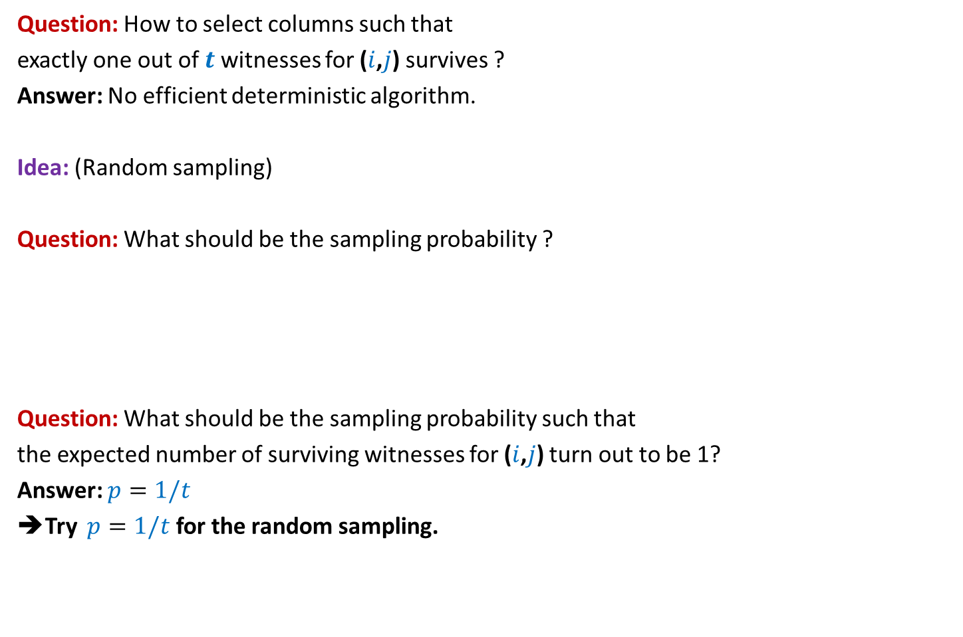
Focus on a single pair ($i$,$j$)
Question: How to select columns such that
exactly one out of $t$witnesses for ($i$,$j$) survives ?
Answer: No efficient deterministic algorithm.
Idea: (Random sampling)
Question: What should be the sampling probability ?
Question: What should be the sampling probability such that
the expected number of surviving witnesses for ($i$,$j$) turn out to be 1?
Answer: $p=1/t$
➔Try $p=1/t$ for the random sampling.
Recall the
generic example
No idea!
Let us ask the following related but easier question.

Slide 34

Focus on a single pair ($i$,$j$)
Question:
If each column is selected independently with $p=1/t$ ,
what is the probability that exactly one out of $t$witnesses for ($i$,$j$) survives ?
Answer:
=$\left({t \atop 1}\right)\frac{1}{t}{\left(1−\frac{1}{t}\right)}^{t−1}$
=${\left(1−\frac{1}{t}\right)}^{t−1}$
= $\frac{1}{2} , \frac{4}{9} , \frac{27}{64} , …, \frac{1}{e}$
$≥\frac{1}{e}$

Slide 35


Randomized algorithm for Computing Witnesses for all pairs with $t$witnesses
//The pseudo code for sampling the (indices of) columns
Sample($n$, $p$)
{ $R$← $∅$;
For each $k∈[n]$ do:
add $k$to $R$ with probability $p$;
return $R$;
}

Slide 36
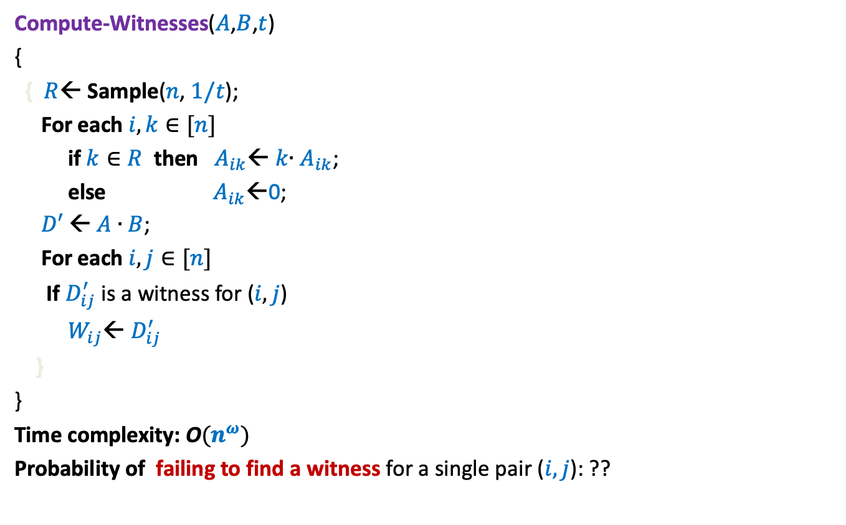

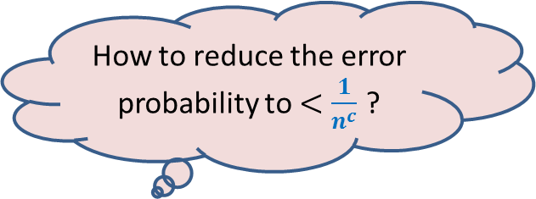
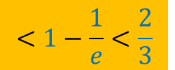
Randomized algorithm for Computing Witnesses for all pairs with $t$witnesses
Compute-Witnesses($A$,$B$,$t$)
{
{ $R$← Sample($n$, $1/t$);
For each $i,k∈[n]$
if $k∈R$ then $A_{ik}$← $k$∙ $A_{ik}$;
else $A_{ik}$←0;
$D′$← $A$ ∙ $B$;
For each $i,j∈[n]$
If $D_{ij}^{′}$ is a witness for ($i,j$)
$W_{ij}$← $D_{ij}^{′}$
}
}
Time complexity: O$(n^{ω})$
Probability of failing to find a witness for a single pair ($i,j$): ??
How to reduce the error probability to $<\frac{1}{n^{c}}$ ?
Repeat the entire process
${c log}_{3/2} n$ times.
$$<1−\frac{1}{e}<\frac{2}{3}$$

Slide 37
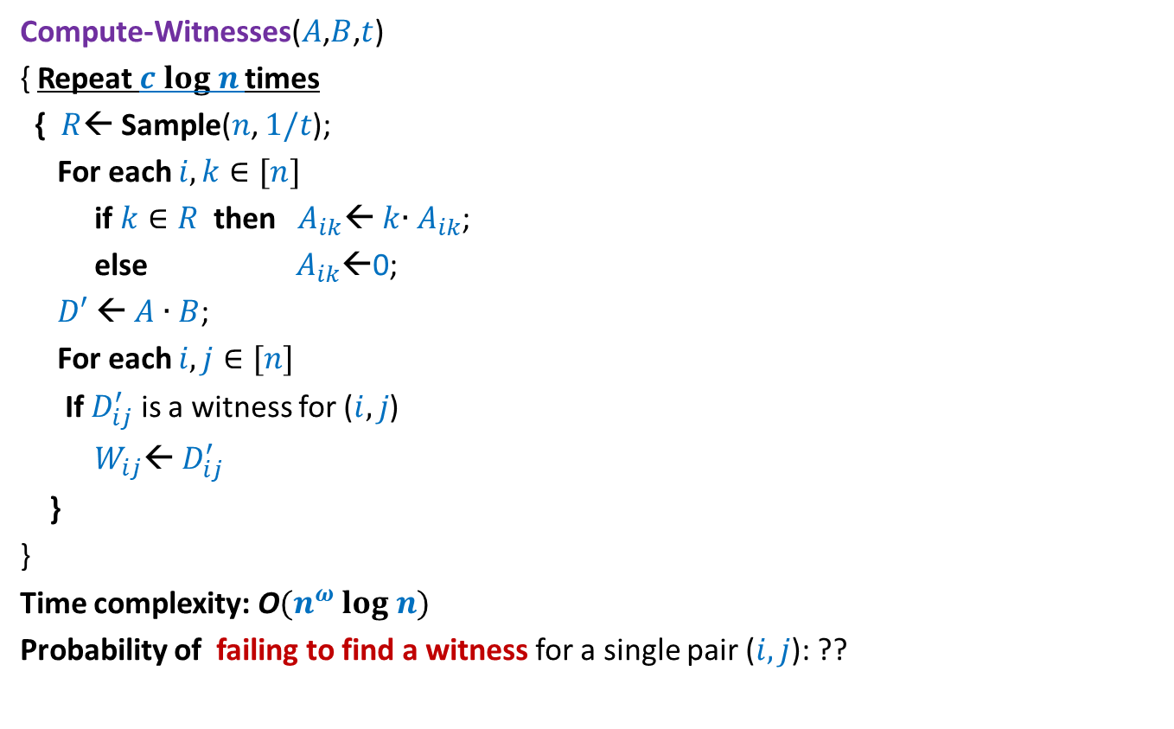
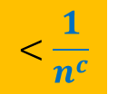
Randomized algorithm for Computing Witnesses for all pairs with $t$witnesses
Compute-Witnesses($A$,$B$,$t$)
{ Repeat $c log n$times
{ $R$← Sample($n$, $1/t$);
For each $i,k∈[n]$
if $k∈R$ then $A_{ik}$← $k$∙ $A_{ik}$;
else $A_{ik}$←0;
$D′$← $A$ ∙ $B$;
For each $i,j∈[n]$
If $D_{ij}^{′}$ is a witness for ($i,j$)
$W_{ij}$← $D_{ij}^{′}$
}
}
Time complexity: O$(n^{ω} log n)$
Probability of failing to find a witness for a single pair ($i,j$): ??
$$<\frac{1}{n^{c}}$$

Slide 38
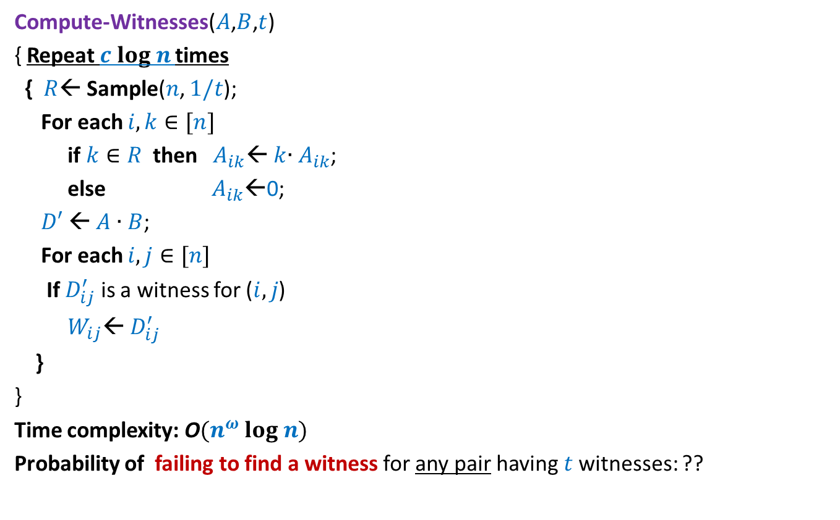
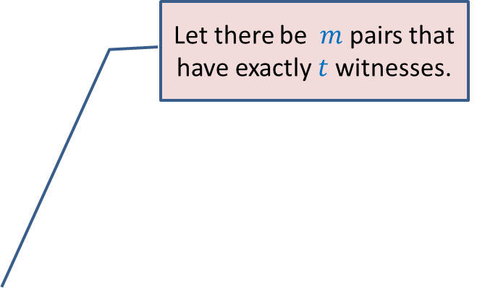

Randomized algorithm for Computing Witnesses for all pairs with $t$witnesses
Compute-Witnesses($A$,$B$,$t$)
{ Repeat $c log n$times
{ $R$← Sample($n$, $1/t$);
For each $i,k∈[n]$
if $k∈R$ then $A_{ik}$← $k$∙ $A_{ik}$;
else $A_{ik}$←0;
$D′$← $A$ ∙ $B$;
For each $i,j∈[n]$
If $D_{ij}^{′}$ is a witness for ($i,j$)
$W_{ij}$← $D_{ij}^{′}$
}
}
Time complexity: O$(n^{ω} log n)$
Probability of failing to find a witness for any pair having $t$witnesses: ??
Apply Union theorem …
Let there be $m$ pairs that have exactly $t$witnesses.
$<\frac{m}{n^{c}}$ < $\frac{1}{n^{c−2}}$

Slide 39
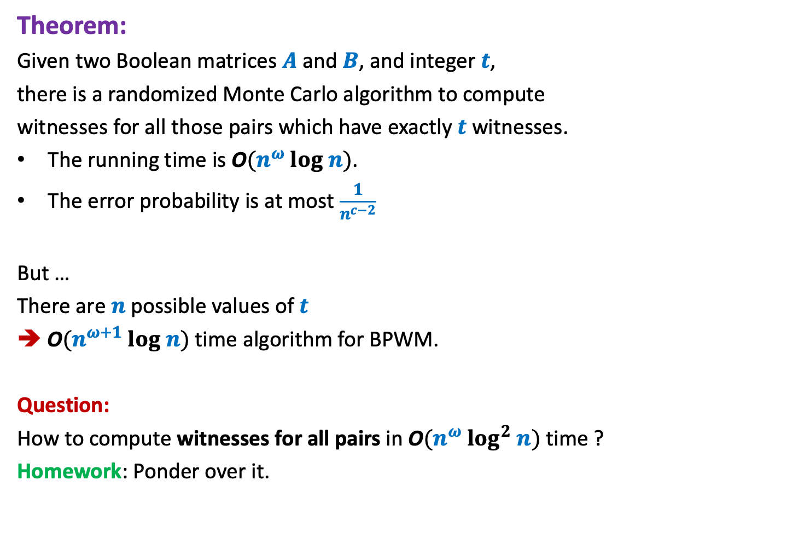
Theorem:
Given two Boolean matrices $A$and $B$, and integer $t$,
there is a randomized Monte Carlo algorithm to compute
witnesses for all those pairs which have exactly $t$ witnesses.
The running time is O$(n^{ω} log n)$.
The error probability is at most $\frac{1}{n^{c−2}}$
But …
There are $n$possible values of $t$
➔ O$(n^{ω+1} log n)$ time algorithm for BPWM.
Question:
How to compute witnesses for all pairs in O$(n^{ω} log^{2} n)$ time ?
Homework: Ponder over it.

Slide 40
Helping Ram distribute the apple among two friends
three
Using least no. of random bits.

Slide 41




How many random bits ?
2-bits Number
$$0 0$$
Shyam
$$0 1$$
Kabir
$$1 0$$
Michael
Repeat
$$1 1$$

Slide 42
Helping Ram distribute the apple among two friends
Using least no. of random bits.

Slide 43
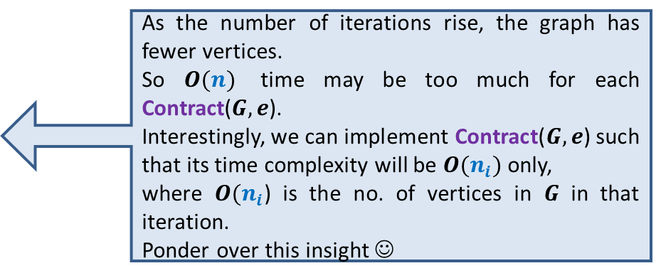
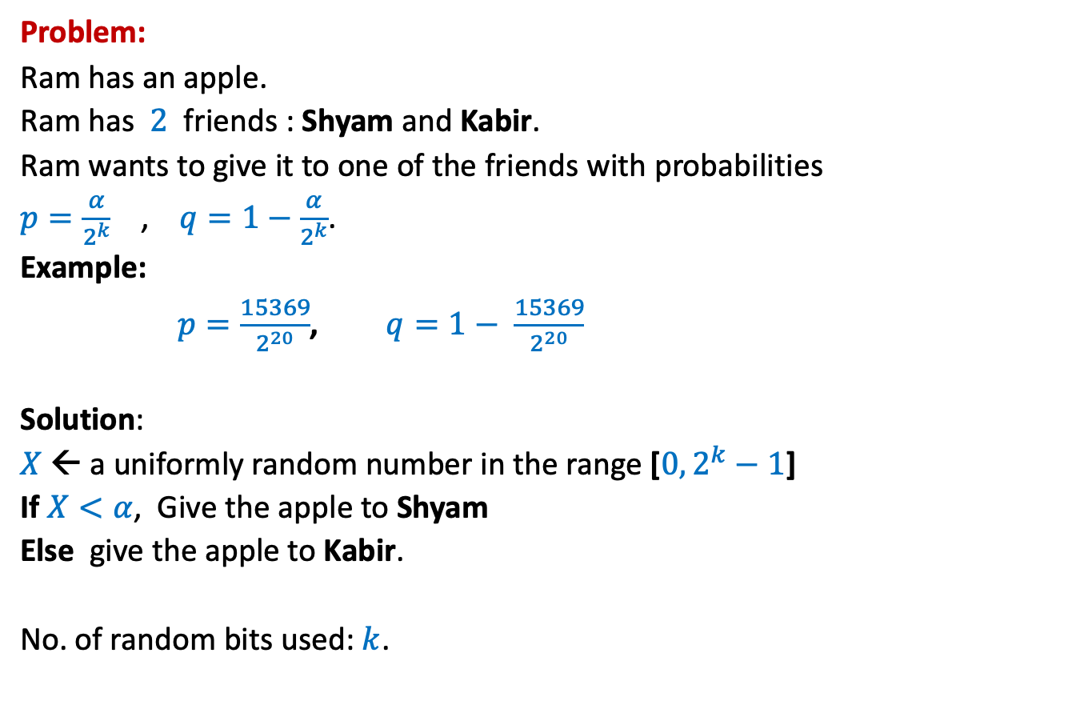
How many random bits ?
Problem:
Ram has an apple.
Ram has $2$ friends : Shyam and Kabir.
Ram wants to give it to one of the friends with probabilities
$p=\frac{α}{2^{k}}$ , $q=1−\frac{α}{2^{k}}$.
Example:
$p=\frac{15369}{2^{20}}$, $q=1− \frac{15369}{2^{20}}$
Solution:
$X$← a uniformly random number in the range [$0,2^{k}−1$]
If $X<α$, Give the apple to Shyam
Else give the apple to Kabir.
No. of random bits used: $k$.
$α$ : any given positive integer $≤2^{k}$
Can we do it in still fewer bits ?
Yes, in expectation ☺

Slide 44

An illustrative example
$$k=2$$
$p=\frac{1}{4}$, and
$1−p=\frac{3}{4}$

Slide 45
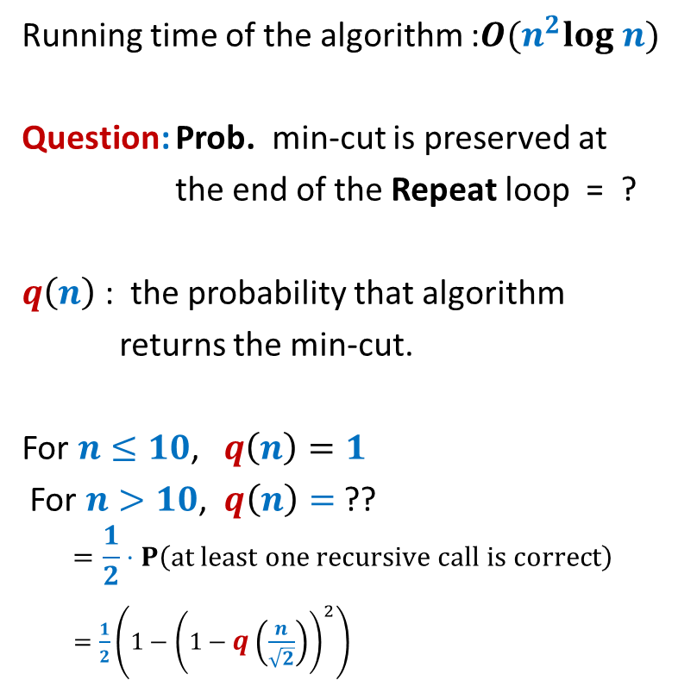
How many random bits ?
2-bits Number
$$0 0$$ | Shyam
$$0 1$$ | Kabir
$$1 0$$
$$1 1$$
Let us generate the random bits lazily
,i.e., only when it is absolutely necessary

Slide 46
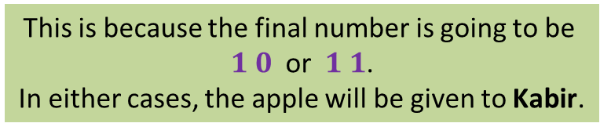


How many random bits ?
No.
2-bits Number
$$0 0$$ | Shyam
$$0 1$$ | Kabir
$$1 0$$
$$1 1$$
This is because the final number is going to be
$1 0$ or $1 1$.
In either cases, the apple will be given to Kabir.
$$1$$
Revealed
If the MSB is $1$,
do we need other bits of the number ?
Let us generate the MSB (Most Significant Bit) first.

Slide 47







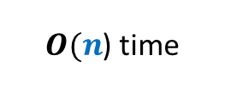


How many random bits ?
Yes.
2-bits Number
$$0 0$$ | Shyam
$$0 1$$
$$1 0$$
$$1 1$$
$X$ : the number of random bits needed.
E[$X$] = $\frac{1}{2}⋅$ E[$X$| MSB is $1$] + $\frac{1}{2}⋅$ E[$X$| MSB is $0$]
= $\frac{1}{2}⋅1+\frac{1}{2}⋅2$ = $\frac{3}{2}⋅$
This is because the final number is going to be
$0 0$ (Shyam)
or $0 1$ (Kabir).
Revealed
$$0$$
But now the problem becomes simpler. Can you see ?
Kabir
If the MSB is $0$,
do we need other bits of the number ?
It is now like the case of $k=1$ now.
$$1$$
$1+$ No. of bits to distribute with $p=\frac{1}{2}$
$$2$$
That is, distributing with $p=\frac{1}{2}$ .

Slide 48

An illustrative example
$$k=3$$
$p=\frac{5}{8}$, and
$1−p=\frac{3}{8}$
Homework: Show that the expected no. of random bits needed is less than 2.

Slide 49
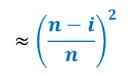
The generic example
$p=\frac{α}{2^{k}}$ , $1−p=\frac{2^{k}−α}{2^{k}}$
Homework: Show that the expected no. of random bits needed is less than 2.

